Slide 1
Enhanced Smart Urban Mobility with Multilingual Support using RAG

Slide 2

INTRODUCTION
Multilingual Traffic Management Systems:
Utilizing Real-Time ML to analyze live traffic data and provide updates and advisories in multiple languages. This not only enhances the efficiency of traffic management but also makes critical information accessible to a broader and more linguistically diverse audience.
Dynamic and Inclusive Public Transport Scheduling:
Implementing Real-Time ML to dynamically optimize and disseminate public transport schedules in multiple languages. This ensures that commuters receive real-time, language-specific information about bus and train services, contributing to a more inclusive and user-friendly public transport experience. The users can select the language of their choice to get the real time traffic updates.
Cross-Lingual Environmental Impact Awareness:
Leveraging Real-Time ML to inform diverse populations about the environmental impact of urban transport in their local languages. By providing real-time insights into the ecological consequences of transportation choices, the project aims to raise environmental awareness and encourage sustainable commuting practices.

Slide 3
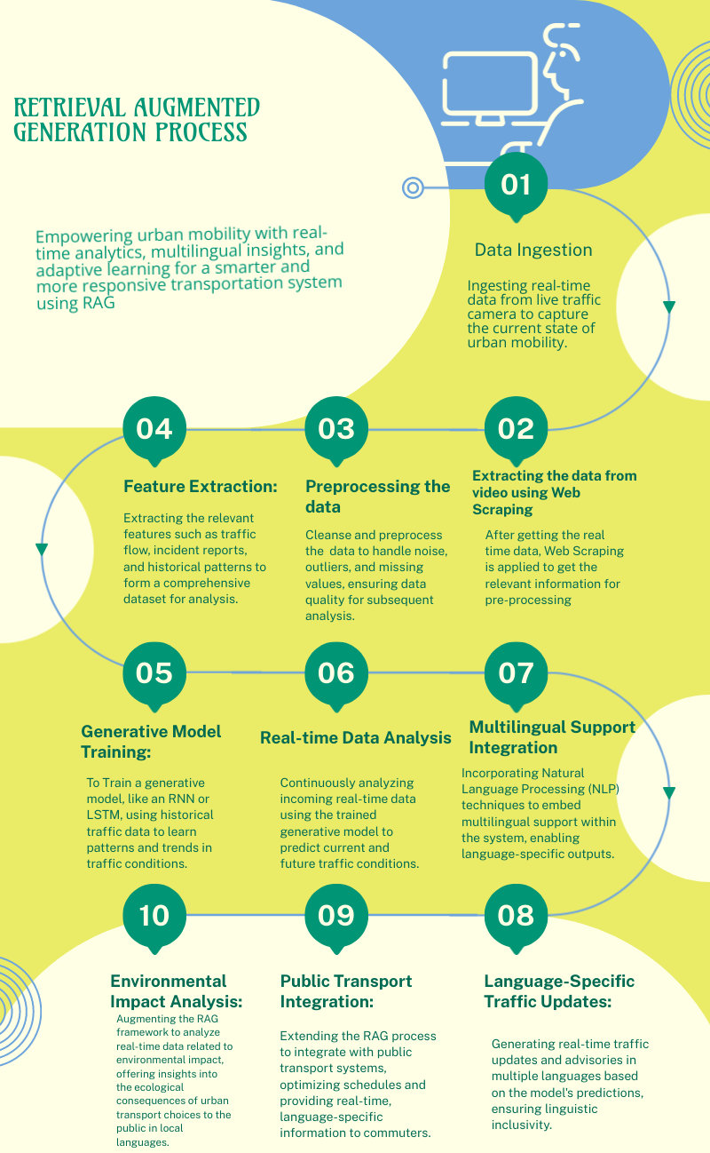
DETAILED WORKFLOW
Usage of RAG Explained : How it is used for Real time Traffic updates and how Multi Linguality is used for giving both real time updates as well as for spreading awareness about the ill effects of the usage of urban transport.

Slide 4

PROBLEM STATEMENT
In the context of urban transportation, There are many problems which are identified that revolve around the challenges of managing traffic congestion, providing reliable public transport scheduling, and fostering awareness about the environmental impact of transportation choices. The increasing complexity of urban mobility, coupled with the diverse linguistic backgrounds of city residents, further exacerbates these challenges.
Traffic congestion often leads to inefficiencies and delays, negatively impacting the overall commuting experience.
Unpredictable public transport schedules contribute to commuter frustration and can deter individuals from relying on public transit.
Additionally, a lack of awareness regarding the environmental consequences of transportation choices hinders the promotion of sustainable practices.
The project aims to tackle the above mentioned issues by employing Real-time Analytics and Generative (RAG) systems, which offer the capability to process live data streams, make real-time predictions, and generate adaptive responses.
Specifically, the project seeks to implement a multilayered solution that includes real-time traffic updates, dynamic public transport scheduling with multilingual information dissemination, and cross-lingual environmental impact awareness.
The incorporation of multilingual support acknowledges the linguistic diversity within urban populations, ensuring that critical information is accessible to a broader audience.
By addressing these challenges through the integration of RAG systems, the project endeavors to transform urban mobility into a more efficient, inclusive, and environmentally conscious experience for all stakeholders involved.

Slide 5

IDEATION PROCESS

Slide 6


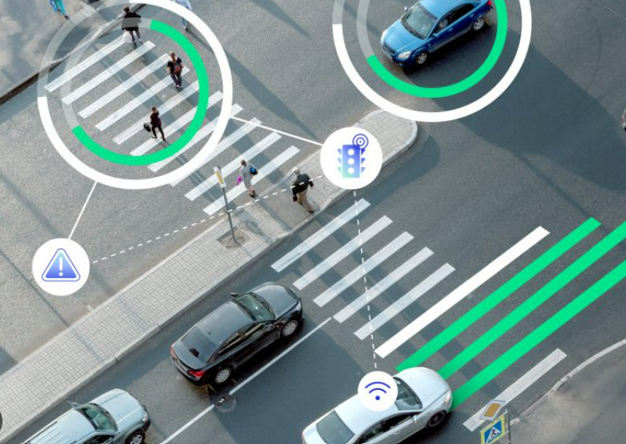
Multilingual Traffic Management Systems
The Multilingual Traffic Management Systems component employs a robust technical architecture to seamlessly integrate Real-time Analytics and Generative (RAG) systems into urban traffic management.
Data ingestion involves tapping into diverse sources such as traffic sensors and GPS devices, with a subsequent preprocessing stage to ensure data quality.
RAG-based traffic analysis leverages machine learning models like Recurrent Neural Networks (RNNs) to predict real-time traffic conditions.
The integration of Natural Language Processing (NLP) techniques and translation services facilitates multilingual support, allowing dynamic generation and dissemination of traffic updates in multiple languages.
Communication channels, including mobile apps and digital displays, are programmed with APIs to effectively disseminate real-time traffic advisories, while user preferences are accommodated through language selection features.
Continuous learning mechanisms ensure the model adapts to changing traffic patterns over time, and a user feedback loop fosters iterative improvements.

Slide 7

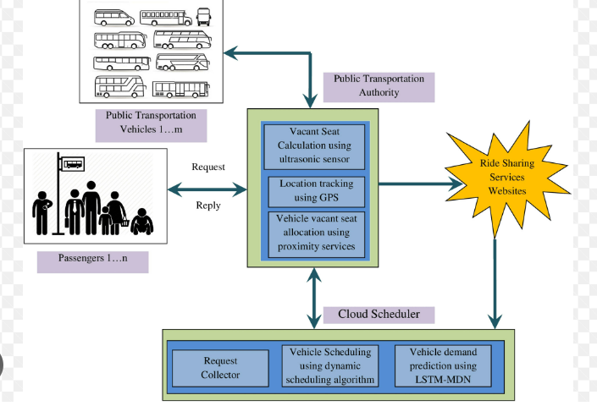
Dynamic and Inclusive Public Transport Scheduling
Dynamic and Inclusive Public Transport Scheduling includes integration with real-time public transport data involves developing interfaces to access schedules, routes, and delays.
Long Short Term Memory (LSTM) based intelligent learner can be used .
This intelligent learner is mainly used to predict high vehicle demand requests in order to utilize a public transport system effectively.
In this way, excess usages of vehicles are reduced from low vehicle demand request locations to the locations where high vehicles demand requests are generated.
Moreover, a new enhanced approach has also been designed to establish communication between the onboard vehicles and the passengers for instant reservation of their seats based on real-time sensors.
To achieve the effective usage of the public transportation system, an effective dynamic scheduling algorithm that dedicates more convenient travel in the complex transportation system
The system results are evaluated using real-time transport data, which are collected from major cities and they are implemented to predict the exact vehicles demand.
Language-specific scheduling and notifications are implemented to enhance user experience, along with user-friendly interfaces and interactive maps for intuitive access to real-time information.
Continuous improvement is achieved through a feedback mechanism and adaptive scheduling, ensuring the system evolves based on user feedback and usage patterns.

Slide 8




Dynamic and Inclusive Public Transport Scheduling

Slide 9

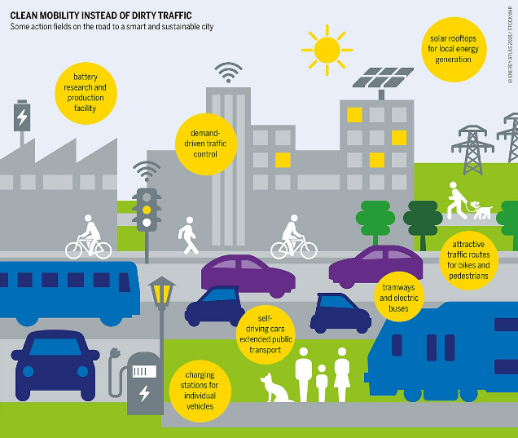
Cross-lingual Environmental Impact Of Transportation Choices Awareness
It will strategically integrate environmental data into the traffic monitoring framework.
This involves establishing connections with sensors to capture real-time data on air quality and emissions.
Subsequent data processing pipelines meticulously analyze and interpret this environmental data, laying the groundwork for effective language-specific communication about the impact of transportation choices on the environment.
Educational efforts are a cornerstone of this initiative, with the creation of informative materials crafted in multiple languages. These materials aim to reach diverse populations, providing accessible information that transcends language barriers.
Complementary to this, community outreach programs and in-app educational initiatives are designed to actively engage users.
It will serve as a comprehensive and responsive solution to the complex environmental issues associated with urban transportation.

Slide 10

PROS OF USING RAG FOR REAL TIME ANALYSIS
Timely Decision-Making:
RAG enables the rapid analysis of live data, allowing for timely decision-making in traffic management and public transport scheduling. This ensures that commuters receive up-to-the-minute information to plan their journeys effectively.
Adaptability to Changing Conditions:
RAG models can adapt to changing traffic conditions, unforeseen incidents, and fluctuations in public transport demand. This adaptability is crucial for maintaining a responsive and efficient urban transportation system.
Personalized User Experience:
By integrating RAG, the project aims to personalize the user experience by delivering information in multiple languages. This enhances accessibility and user engagement, catering to the diverse linguistic preferences of urban populations.
Continuous Improvement:
RAG allows for continuous model improvement based on incoming data. The system can learn from patterns and trends, ensuring that it remains effective in addressing the evolving challenges of urban mobility and environmental impact

Slide 11

CONSIDERATIONS
Data Privacy and Security:
Ensuring strict adherence to data privacy regulations, especially when dealing with real-time traffic data and user information.
Scalability:
Designing the system with scalability in mind to handle growing data volumes and user interactions. Considering the potential expansion to other cities or regions.
Interoperability:
Ensuring compatibility and interoperability with existing urban infrastructure, public transport systems, and smart city initiatives to facilitate seamless integration.
User Experience:
Prioritizing a user-centric design to enhance the overall experience for commuters. User interfaces should be intuitive, accessible, and inclusive, especially for those with varying levels of technical proficiency.
Regulatory Compliance:
Staying compliant with local regulations, traffic laws, and environmental standards.

Slide 12

CONSTRAINTS
Data Availability and Quality:
Relying on real-time data necessitates the availability and quality of data sources. Inaccurate or incomplete data may impact the accuracy of predictions and advisories.
Technological Limitations:
Recognize potential technological limitations, especially in regions with less developed infrastructure. Access to high-speed internet and advanced technologies may vary.
Language Resource Limitations:
Accurate Availability of language resources for training language models and providing translations may be limited.
Public Transport System Cooperation:
Cooperation with public transport authorities is crucial. Constraints may arise if these entities are unwilling or face challenges in integrating their systems with the proposed solutions.
Community Resistance:
Resistance from the community or specific user groups may arise due to concerns about privacy, changes in public transport routines, or skepticism about the effectiveness of the proposed system.
Regulatory Barriers:
Legal and regulatory barriers may impede certain aspects of the project, such as the deployment of certain technologies or the dissemination of specific information.

Slide 13

REFERENCES
https://github.com/YIZHUSTC/InsightDE
https://www.sciencedirect.com/science/article/pii/S2772671123001067
https://www.mdpi.com/2071-1050/10/10/3686
https://www.c40knowledgehub.org/s/article/How-cities-can-make-public-transport-inclusive-equitable-and-accessible-for-everyone?language=en_US

Slide 14

Done By:
TRISHAA S
SHIV NADAR UNIVERSITY CHENNAI
Team Name: Lone Wolf

